Slide 1

Computer vision.
DATA ANALYTICS | IRONHACK

Slide 2
Neural networks:
Neural networks can be seen as layered set of neurons working together to achieve a goal.
Every neuron collects inputs from the previous layers and combines them using some weights ( to be determined ) into a linear model response.
Then a activation function is applied to the resulting linear model of each neuron and the output is sent to the next layer. There are several activation functions:
Sigmoid ( logistic model )
Tanh
RELU
softmax

Slide 3
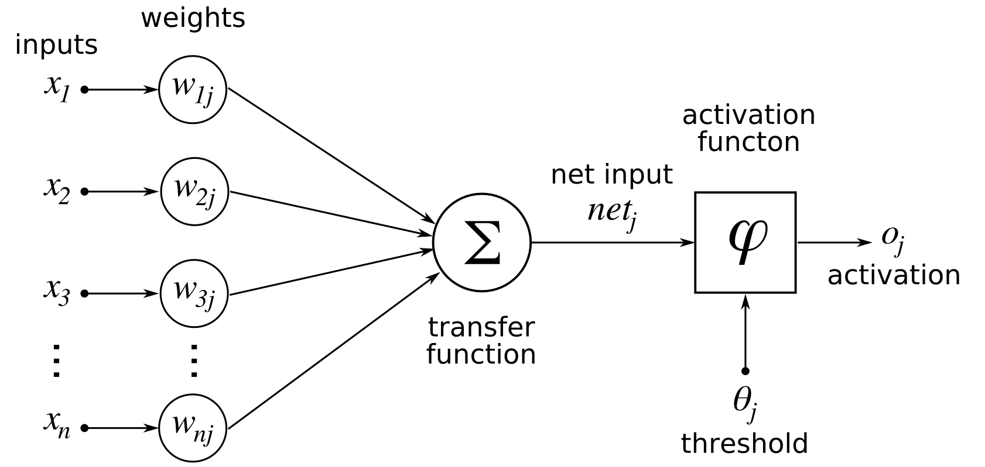
Perceptron
The perceptron is the most simple type of neural network.
It only contains one neuron:

Slide 4
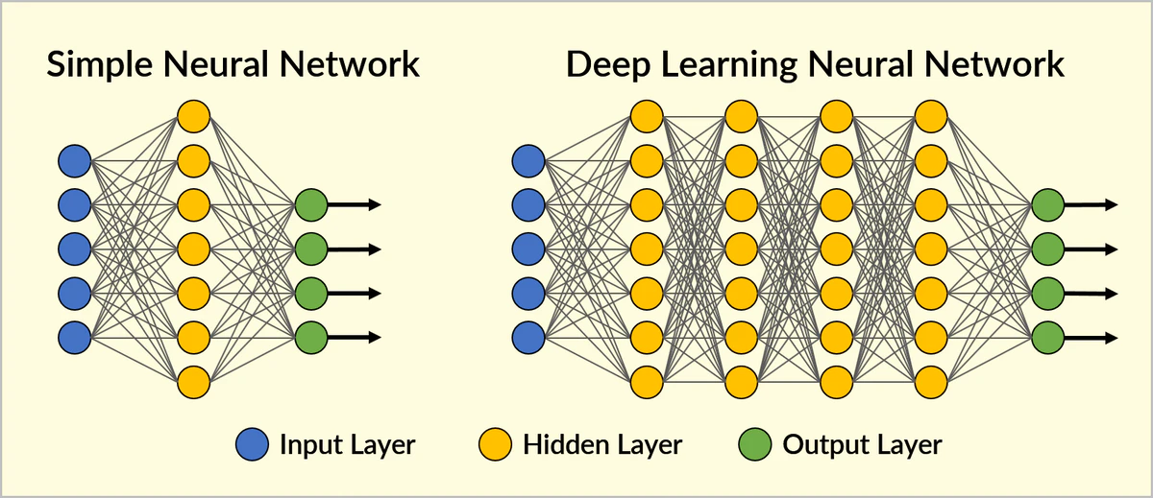
Feed forward neural networks

Slide 5
Architecture of a neural network:
The architecture of a neural network is defined by:
Number of hidden layers
Activation functions in every neuron
Output layer
The number of parameters in the neural network is given by the amount of neurons, which is usually a huge number.
Given the huge amount of parameters that the neural network has, they are:
Difficult to train ( you need a huge amount of observations )
Time consuming ( usually GPU’s or TPU’s are used )
Overfitting ( the neural networks can be made so complex that they can be trained for everything )

Slide 6
Types of neural networks:
Each type of neural network is best suited for some specific task:
Regression
Classification ( one output neuron for each class in multiclass classification )
Recurrent neural network ( RNN ) used for time series
Encoding ( Autoencoders ) used for data compression-decompression
Self organizing maps
Recommender systems
Image recognition ( convolutional neural networks CNN )

Slide 7



Image preprocessing:
Neural networks used for image recognition usually have a first preprocessing step before.
The preprocessing steps are:
Convolution
Pooling
Flatenning
The real neural network starts after these steps, eve though usually those steps are included in the neural network.
The main library to use for training a neural networks are:
Tensorflow ( made by google )
Keras ( wrapper of Tensorflow )
PyTorch

Slide 8
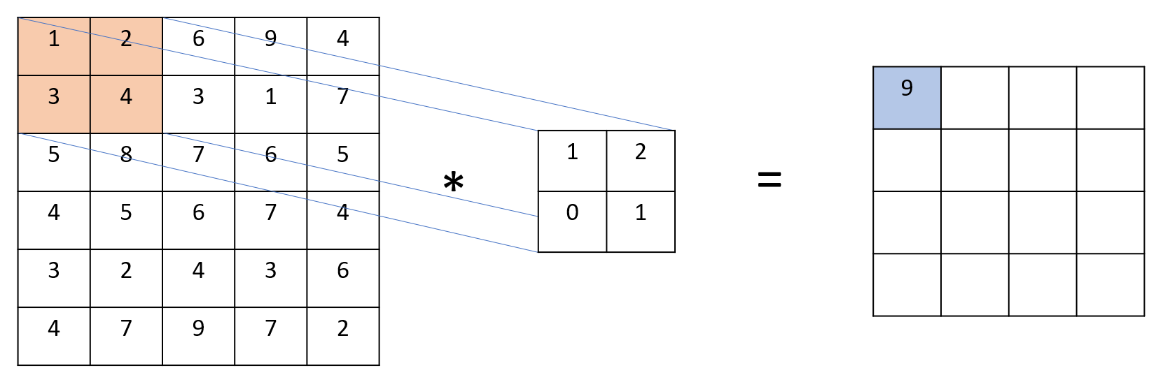
Convolution:
An image is a collection of data called pixels.
Each pixel can have a grey color level between 0 and 255.
For color images, the image is composed by three layers of pixels ( red, green, blue )
Convolution is a mathematical operation taken over a subset of of pixels in an sliding window ( one pixel sliding ) centered on a given pixel:

Slide 9

Pooling:
Pooling is a process to reduce the image size by aggregating pixel values on the image:
Max pooling
Min pooling
Average pooling

Slide 10
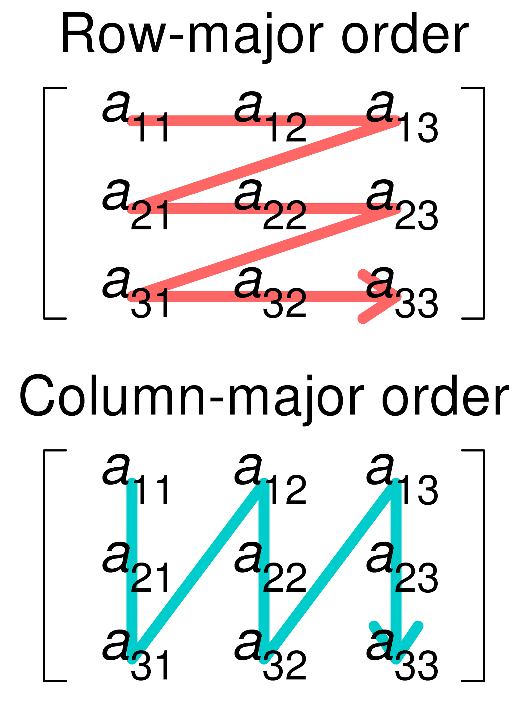
Flattening:
Flattening is a process to re-arrange the image (2D) as a (1D) array which can be used as an input layer on a feed forward neural network.

Slide 11

Convolutional neural networks:

Slide 12
IMPLEMENTATION:
In order to implement all previous steps, we will have to add a few layers before the regular feed forward neural network:
model = models.Sequential()
model.add(layers.Conv2D(number_of_filters, (filter_size_x, filter_size_y), activation='relu', input_shape=(size_x,size_x, channels)))
model.add(layers.MaxPooling2D((pooling_size_x, pooling_size_y)))
model.add(layers.Conv2D(number_of_filters, (filter_size_x,filter_size_y), activation='relu'))
model.add(layers.MaxPooling2D((pooling_size_x, pooling_size_y)))
model.add(layers.Conv2D(number_of_filters, (filter_size_x, filter_size_y), activation='relu'))
model.add(layers.Flatten())
…

Slide 13
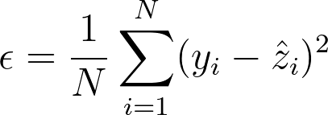
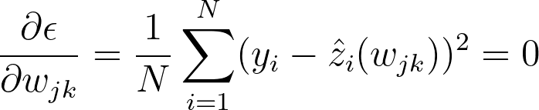
Training neural networks:
Training the neural network involves determining the network weights.
To this end, the error metrics is minimized based on this weights. How it will change the error metrics as long as the weights are modified?
This process is called backpropagation.

Slide 14
Training neural networks:
Training a neural network means determining the coefficients: wkl and the values of the filters.
To prevent overfitting, not all the training pass through the neural network
To do this, the training set is split in subsets called “batches”.
Initial weights values are assigned to the weights and filters following a gaussian distribution.
Then each batch is sent to the neural network in order to find out what could be the best weights.
The optimal weights for the previous batch are used an starting guess for the next one.
One pass through all the batches, is called “epoch”. ( typically 100’s )
Usually several epochs are needed in order to minimize the error metrics.
Batch 1
Batch 2
Train
Batch 3
Batch 4
Epoch = Batch 1 + Batch 2 + Batch 3 + Batch 4

Slide 15
Overfitting:
A simple neural network can easily have hundreds of thousands of weights
Therefore is a very complex model than can easily fit anything, which makes very prone to suffer from overfitting.
To minimize the overfitting, a few regularization techniques can be used:
L1 or L2 regularization
Dropout ( switch off some randomly selected neurons of one hidden layer during the training )

Slide 16


